Slide 1
ANNUAL RATE REVIEW CITY & BOROUGH OF WRANGELL
Mason Villarma, Borough Finance Director

Slide 2
Work session agenda
Process and Goals
Key Considerations When Addressing Rates
WML&P (Electric) Fund
Water Fund
Ports & Harbors Fund
Wastewater Fund
Sanitation Fund
Discussion

Slide 3
Process & Goals
March 14th – Work Session on Borough Rates
March 28th – Approval of Borough Rate Schedule
March – May Budget Development
June 13th – Budget Adopted
Process
Goals
Ordinance 1026 (6/24/2022) added section 5.14.025 of the WMC providing for annual review and approval of all Borough rates
This aids in development of the revenues in the Annual Budget
Preserve profitability of the Borough’s enterprise funds
Aim to be financially sustainable w/ limited dependence on State and Federal assistance (i.e., demonstrate the financial capacity to pay an annual debt service for a revenue bond
Ensure other rates outside of our enterprise funds at least cover the “cost of doing business”
ANNUAL RATE REVIEW

Slide 4
Key Components of Rates
Unrestricted Fund Balance / Working Capital
Depreciation on Infrastructure that is already placed in service
Revenues over (Expenses) / Net Income
Future CapEx (i.e., capital equipment and infrastructure needs)
Inflation
Level of State & Federal Assistance

Slide 5
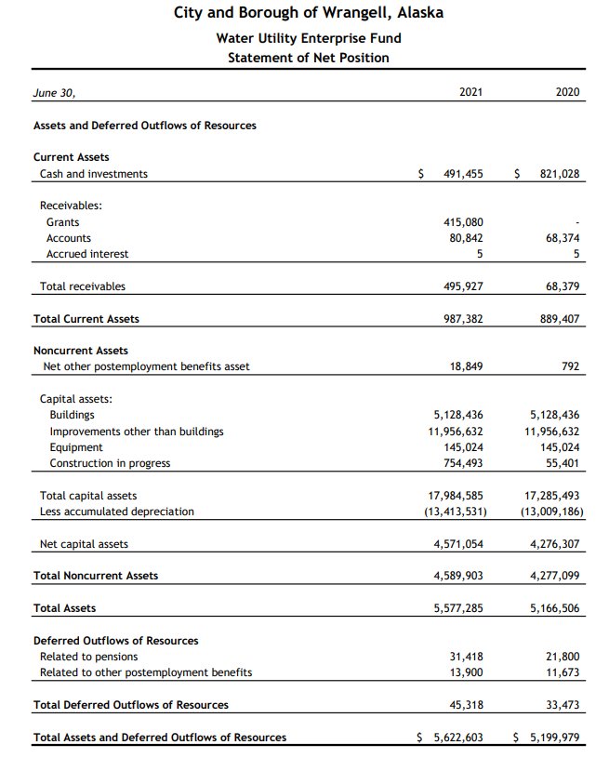
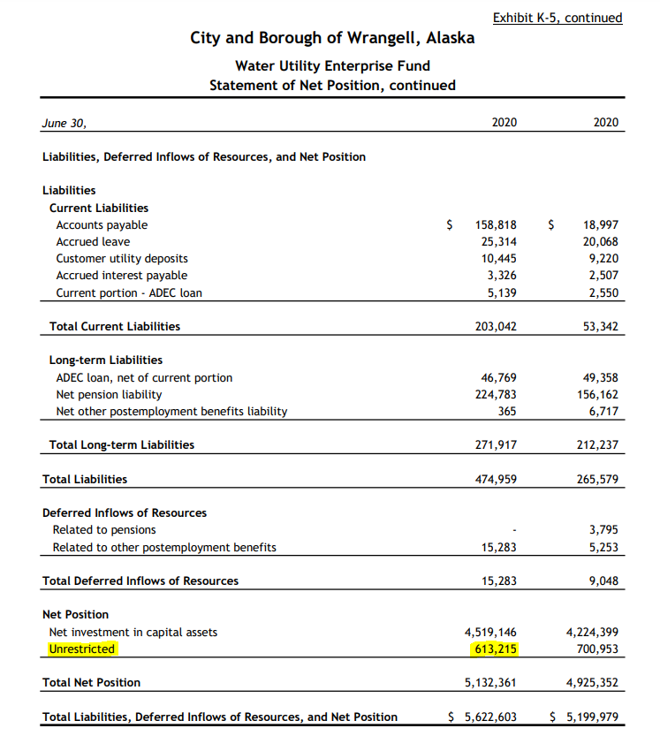
Unrestricted Fund Balance & Working Capital
Unrestricted Fund Balance is what the fund has in “reserves” and is not committed or restricted for another purpose
Working Capital is the funds current assets less its current liabilities. It demonstrates the funds' ability to meet its short-obligations

Slide 6
Depreciation
Depreciation represents the estimated reduction in value of fixed assets (i.e., buildings, equipment, infrastructure, etc.) within a fiscal year.
Accumulated Depreciation is the sum of depreciation that is carried over each fiscal period
Fixed Assets – A/D = BV of Assets
Depreciation is a useful tool to understand if our operations are sustainable
Important Questions to Ask:
How much of the fund’s fixed assets have already been depreciated and is not reflected in annual depreciation?
Do we need the same infrastructure and equipment that we had in the past?
If so, are we generating enough income to sustain operations?

Slide 7
Revenues over (Expenses) / Net Income
Beginning Fund Balance + Net Income (loss) = Ending Fund Balance
It is important to understand income generated from continuing operations as it demonstrates what our financial capacity is to bond for projects
[Net Income from Operations / Annual Debt Service] = >1.25
If not, then we do not demonstrate a strong ability to pay off future debt related to projects
If net income is not sufficient to demonstrate the financial capacity to bond for future obligations, then rates should be adjusted accordingly

Slide 8
FUTURE CAPITAL NEEDS
What are the future capital needs of each fund?
Every year long-term fiscal models are updated with prior FY numbers and any changes to the capital plan. As a group, fund leaders, finance, and administration analyze various scenarios, focusing on the impact to:
Fund Balance
Debt Levels
Other restrictions (i.e., financial covenants)

Slide 9
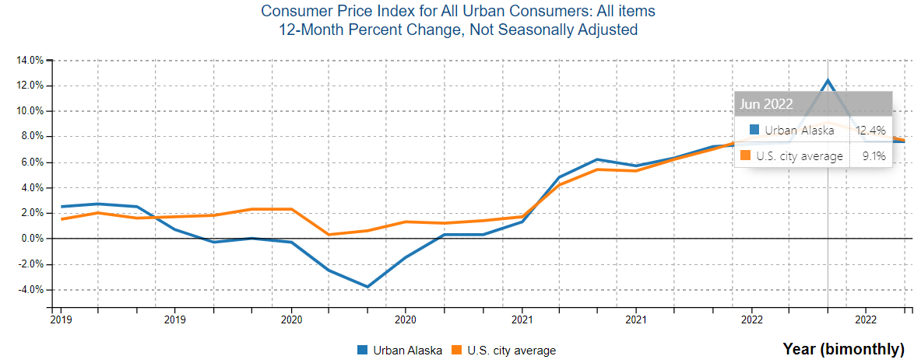
Inflation

Slide 10
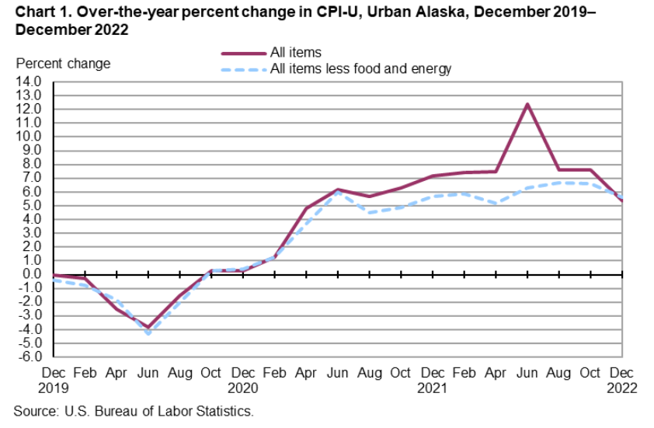
Inflation

Slide 11
Wml&p (Electric Fund)
Fund 70000 & 70300

Slide 12
WML&P Summary
Actual - Unrestricted Fund Balance (6/30/2022) = $ 2,709,629
Projected - Unrestricted Fund Balance (6/30/2023) = $ 3,150,308
Average Operating Net Income (2017-2022) = $ 214,932
Average Operating Net Income After Depreciation (2017-2022)= ($ 67,223)
FY 2022 Depreciation Expense = $ 226,739
Fixed Assets = $ 8,202,819
Accumulated Depreciation= $ 6,596,716
Net Fixed Assets = $ 1,606,103

Slide 13
WML&P Net Income vs. Depreciation

Slide 14
Projections for fy2023

Slide 15
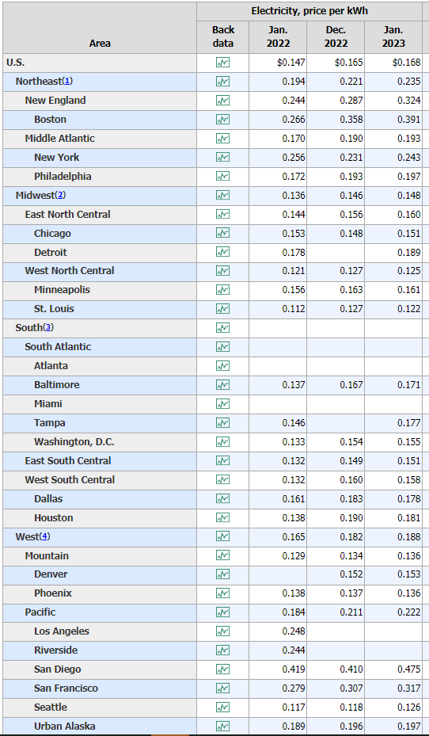
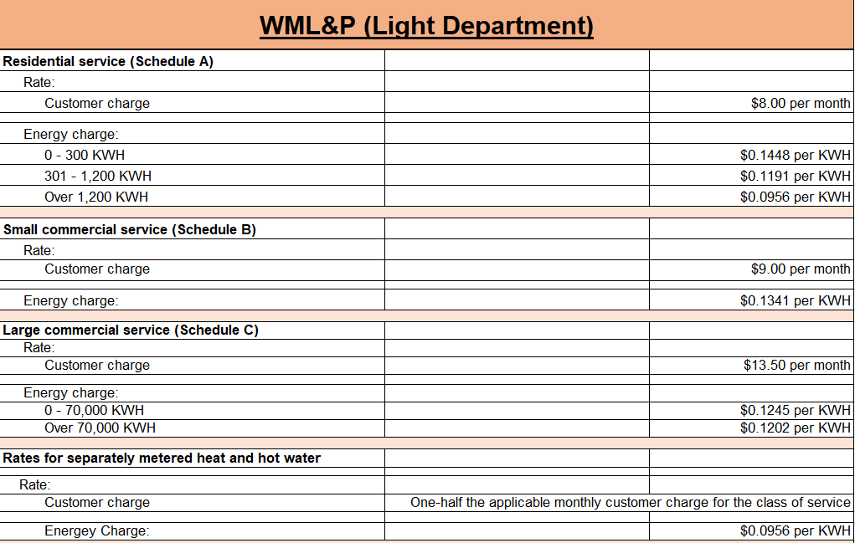
$/kwh Comparison

Slide 16
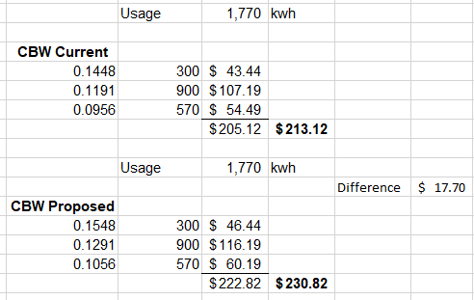
Fy2024 rate proposal – wML&P
$0.01 per kWh increase across all tiers
Service Connection/Permit Fees to stay the same
Change the Fuel Surcharge formula to: Cost of Fuel Used/Total kWh per month
Example: A Wrangell resident consumes 1,770 kWh in January. The image to right shows the difference in cost in FY23 vs the proposed rates in FY24:

Slide 17
Capex modeling – wml&P
Model is constructed as follows:
7.5% for FY2024
5.5% thereafter
3.5% Projected Average Inflation for next 20 years
Allows for replacement of capital assets on major maintenance/capital projects listing
Maintains reserve balance sufficient to address unforeseen material costs

Slide 18
Water Fund
Fund 72000 & 72300

Slide 19
Water fund Summary
Actual - Unrestricted Fund Balance (6/30/2022) = $ 1,353,557
Projected - Unrestricted Fund Balance (6/30/2023) = $ 1,506,212
Average Operating Net Income (2017-2022) = $ 78,245
Average Operating Net Income After Depreciation (2017-2022)= ($ 495,114)
FY 2022 Depreciation Expense = $ 435,277
Fixed Assets = $ 18,289,065
Accumulated Depreciation= $ 13,848,808
Net Fixed Assets = $ 4,440,257

Slide 20
Water Fund Net Income vs. Depreciation

Slide 21
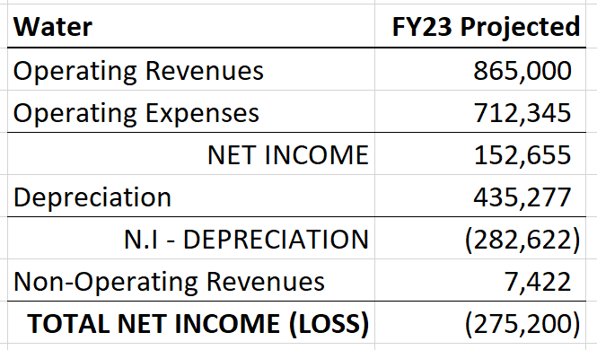
Projections for fy2023

Slide 22
Fy2024 rate proposal – water
10% increase across all rates categories
Some omissions and changes to rate categories will be proposed to create more parity in the rate structure.
Example: A residential user would be charged $67.43 under this proposal vs. $61.30 at the current rate. This is a $73.56 annual impact.

Slide 23
Capex modeling – water fund
Model is constructed as follows:
10.0% increase for FY2024
5.5% thereafter
3.5% Projected Average Inflation for next 20 years
Allows for replacement of capital assets on major maintenance/capital projects listing
The Dam Abutment Project cannot be afforded without state or federal assistance in this model
Water is the laggard of all enterprise funds.
Support from state and federal agencies is a must for sustainability in the long-term

Slide 24
Ports & Harbors Fund
Fund 74000 & 74300

Slide 25
P&H fund Summary
Actual - Unrestricted Fund Balance (6/30/2022) = $ 3,134,860
Projected - Unrestricted Fund Balance (6/30/2023) = $ 3,910,020
Average Operating Net Income (2017-2022) = $ 504,395
Average Operating Net Income After Depreciation (2017-2022)= ($ 1,511,471)
FY 2022 Depreciation Expense = $ 2,201,411
Fixed Assets = $ 66,623,679
Accumulated Depreciation= $ 32,236,132
Net Fixed Assets = $ 34,387,547

Slide 26
P&H Fund Net Income vs. Depreciation

Slide 27
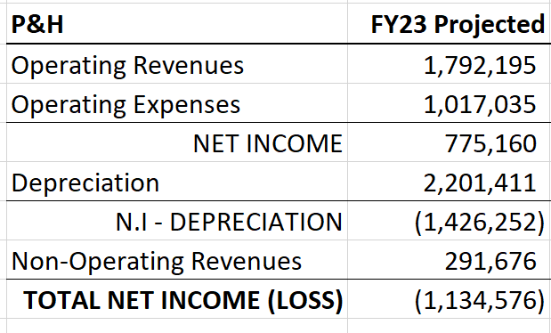
Projections for fy2023

Slide 29
Fy2024 rate proposal – P&H
11.1% increase across all rates categories w/ the exception of fees targeting cruise ships & passengers
Harbor master plans to present new rates effective 1/1/2024 for the Port
Example: A limit-seiner at 58ft paid $2,433.68 for stall rent in FY23. If the proposed rates went into effect, the same customer would pay $2,703.82. A $270.14 difference Y/Y.
Port Commission Approved

Slide 30
Capex modeling – P&H fund
Model is constructed as follows:
11.1% increase for FY2024
5.5% thereafter
3.5% Projected Average Inflation for next 20 years
Capital projects are so large that P&H will need “outside” financial assistance to get passed three hurdles: 1) Barge Ramp 2) Wrangell Inner Harbor Basin 3) Meyers Chuck
The goal is to get the fund to be able to support at least a $10M debt service, or provide over $5M in matching grant funds

Slide 31
wastewater Fund
Fund 76000 & 76300
ANNUAL RATE REVIEW

Slide 32
wastewater fund Summary

Slide 33
wastewater Fund Net Income vs. Depreciation

Slide 34
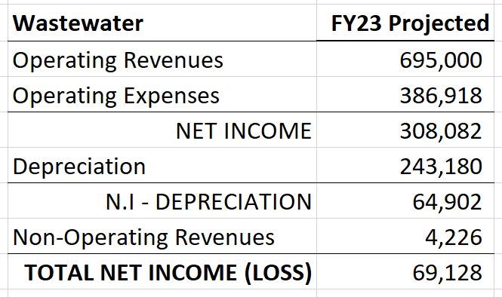
Projections for fy2023

Slide 35
Fy2024 rate proposal – wastewater
15% increase across all rates categories
Some omissions and changes to rate categories will be proposed to create more parity in the rate structure.
Example: A residential user would be charged $56.70 under this proposal vs. $49.30 at the current rate. This is a $88.74 annual impact.

Slide 36
Capex modeling – WW Fund
Model is constructed as follows:
15.0% increase for FY2024
5.5% thereafter
3.5% Projected Average Inflation for next 20 years
Fund is able to address next three large capital projects via financing through a revenue bond or use of reserves.
Fund will maintain a sufficient fund balance to address unforeseeable material costs incurred.

Slide 37
SANITATION Fund
Fund 78000 & 78300
ANNUAL RATE REVIEW

Slide 38
SANITATION fund Summary
Actual - Unrestricted Fund Balance (6/30/2022) = $ 408,651
Projected - Unrestricted Fund Balance (6/30/2023) = $ 643,509
Average Operating Net Income (2017-2022) = $ 133,931
Average Operating Net Income After Depreciation (2017-2022)= ($ 101,822)
FY 2022 Depreciation Expense = $ 99,234
Fixed Assets = $ 1,881,569
Accumulated Depreciation= $ 1,255,817
Net Fixed Assets = $ 625,752

Slide 39
SANITATION Fund Net Income vs. Depreciation

Slide 40
Fy2024 rate proposal – SANITATION
5.5% increase across all rates categories
Call out and unsorted garbage rate added
Example: A residential user would be charged $52.33 for monthly garbage collection of a 64-Gal container under the proposed rate increase. The current rate is $49.60. The total annual impact would be $32.74.

Slide 41
Capex modeling – sanitation
Model is constructed as follows:
5.5% increase for FY2024
5.5% thereafter
3.5% Projected Average Inflation for next 20 years
Fund is able to contribute to the loading dock project and purchase a new garbage truck in FY25.
Fund will maintain a sufficient fund balance to address unforeseeable material costs incurred.

Slide 42
Impact to Ratepayers - Wrangell
FY 2023 (Current) Rates
Residential Rates | Use | Rate | Fees | Sales Tax | Total
Electric (Base of $8) | 1500 | $ 0.1195 | $ 187.31 | $ 13.11 | $ 200.42
Water | Flat | $ 61.30 | $ 61.30 | $ 4.29 | $ 65.59
Wastewater | Flat | $ 49.30 | $ 49.30 | $ 3.45 | $ 52.75
Sanitation (96-gallon bin) | Flat | $ 62.40 | $ 62.40 | $ 4.37 | $ 66.77
Total Bill |  |  |  |  | $ 385.53
FY 2024 Proposed Rates
Residential Rates | Use | Rate | Fee | Sales Tax | Total
Electric | 1500 | $ 0.1295 | $ 202.31 | $ 14.16 | $ 216.47
Water | Flat | $ 67.43 | $ 67.43 | $ 4.72 | $ 72.15
Wastewater | Flat | $ 56.70 | $ 56.70 | $ 3.97 | $ 60.66
Sanitation (96-gallon bin) | Flat | $ 65.83 | $ 65.83 | $ 4.61 | $ 70.44
Total Bill |  |  |  |  | $ 419.73
 |  |  |  | Total Monthly Impact | $ 34.19
 |  |  |  | Total Annual Impact | $ 410.33
ANNUAL RATE REVIEW

Slide 43
Impact on ratepayers - Sitka
 |  | Current (FY23) rates |  |  |  | Proposed FY24 rates |  |  |  |  | Monthly Increase | Season Increase
Winter Rates (November-April) | Use | Rate | Fees | Sales tax | TOTAL | Increase | Rate | Fees | Sales tax | TOTAL
Electric (family/electric heat) | 2835 | 0.131 | 390.5 | 19.52 | 409.97 | 3.00% | 0.134 | 401.5 | 20.08 | 421.58 | 11.61 | 69.66
Water | Flat | 54.02 | 54.02 | 2.7 | 56.72 | 6.00% | 57.26 | 57.26 | 2.86 | 60.12 | 3.4 | 20.4
Wastewater | Flat | 70.71 | 70.71 | 3.54 | 74.25 | 8.50% | 76.72 | 76.72 | 3.84 | 80.56 | 6.31 | 37.86
Solid Waste (96-gallon bin) | Flat | 69.89 | 69.89 | 3.49 | 73.38 | 6.75% | 74.61 | 74.61 | 3.73 | 78.34 | 4.96 | 29.76
Total Winter bill |  |  |  |  | $614.32 |  |  |  |  | $640.60 | $26.28 | $157.68
Summer Rates (May-October) | Use | Rate | Fees | Sales tax | TOTAL |  | Rate | Fees | Sales tax | TOTAL
Electric (family/electric heat) | 1581 | 0.209 | 350.4 | 21.03 | 371.46 | 3.00% | 0.215 | 360.4 | 21.62 | 382.02 | 10.56 | 63.36
Water | Flat | 54.02 | 54.02 | 3.24 | 57.26 | 6.00% | 57.26 | 57.26 | 3.44 | 60.7 | 3.44 | 20.64
Wastewater | Flat | 70.71 | 70.71 | 4.24 | 74.95 | 8.50% | 76.72 | 76.72 | 4.60 | 81.32 | 6.37 | 38.22
Solid Waste (96-gallon bin) | Flat | 69.89 | 69.89 | 4.19 | 74.08 | 6.75% | 74.61 | 74.61 | 4.48 | 79.09 | 5.01 | 30.06
Total Summer bill |  |  |  |  | $537.29 |  |  |  |  | $603.13 | $25.38 | $152.28
Total annual impact |  |  |  |  |  |  |  |  |  |  |  | $309.96

Slide 44
DISCUSSION

